Slide 1
Personal Fitness Lesson #4
Nutrition

Slide 2
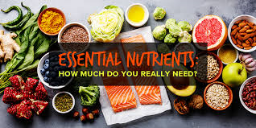
Essential Nutrients
It is a nutrient that the body cannot synthesize on its own– or not to and adequate amount– and it must be provided by the diet.
These nutrients are necessary for the body to function properly. The 6 essential nutrients are:
Carbohydrates
Protein
Fats
Vitamins
Minerals
Water

Slide 3
Carbohydrates
Main source of energy.
The two main forms of carbohydrates are: sugars such as fructose, glucose, and lactose. Starches, which are found in foods such as starchy vegetables (like potatoes or corn), grains, rice, breads, and cereals
COMPLEX CARBOHYDRATES→ these are the healthiest sources of carbohydrates.
It is unprocessed or minimally processed
Whole grains, vegetables, fruits and beans
Promotes good health by delivering vitamins, minerals, fiber, and a host of phytonutrients (a substance found in certain plants which is believed to be beneficial to human health and help prevent various diseases)
SIMPLE CARBOHYDRATES→ unhealthier source of carbohydrates
Highly processed or refined foods
White bread, pastries, soda.
These make it easier to gain weight, interfere with weight loss and promotes diabetes and heart disease

Slide 4
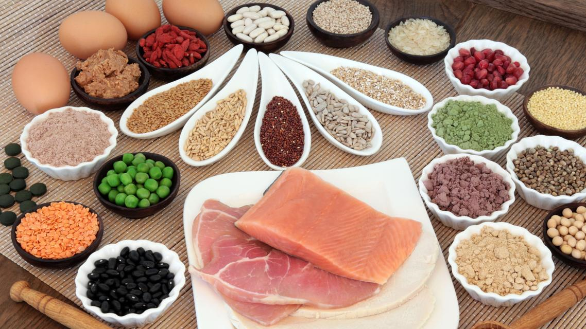
Protein
Builds, maintains and replaces the tissues in your body.
It comes from a variety of sources (usually people think just meat, but where else?)
Meat, milk, fish, soy, and eggs. Also, beans, legumes and nut butters.
When proteins are digested, they leave behind amino acids (building blocks of protein), which the human body needs.
What are the benefits of having protein?
Speeding recovery after exercise
Reducing muscle loss
Building lean muscle
Helping you maintain a healthy weight
Curbing hunger

Slide 5
Fat Provides energy, insulates, supports and cushions the organs
SATURATED FATS
UNSATURATED FATS
Raise your LDL (bad) cholesterol level.
High LDL can put you at risk of a heart attack, stroke, and other major health problems.
Foods with a lot of saturated fats are animal products like
Butter, cheese, whole milk, ice cream, cream and fatty meats
Some vegetable oils: coconut, palm and palm kernel oil for example.
Eating unsaturated fats instead of saturated fats can help lower you LDL cholesterol.
There are two kinds of unsaturated fats:
Monosaturated fats: includes olive and canola oils
Polyunsaturated fats: includes sunflower, corn, and soy oil

Slide 6
Water
Makes up approximately 60% of your body weight; transports chemicals; regulates temperature; removes waste products
Since we are constantly losing waster from our bodies; especially through urine and sweating. How can we get the needed water back in our bodies?
It is recommended to drink eight 8-ounce glasses per day.

Slide 7
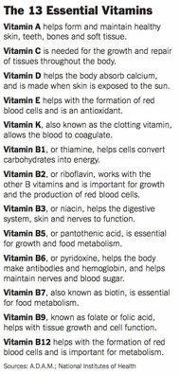
Vitamins
Any group of organic compounds that are essential for normal growth and nutrition and are required in small quantities in the diet because they cannot be synthesized by the body.
There are 13 essential vitamins
They will boost your immunity
Strengthen your bones
Heal wounds
Bolster your eyesight
Assist you in obtaining energy from food among multiple other functions.
Without adequate vitamin intake you may feel
Lethargic and it will be easier to get an infection and other serious complication that can endanger your health

Slide 8
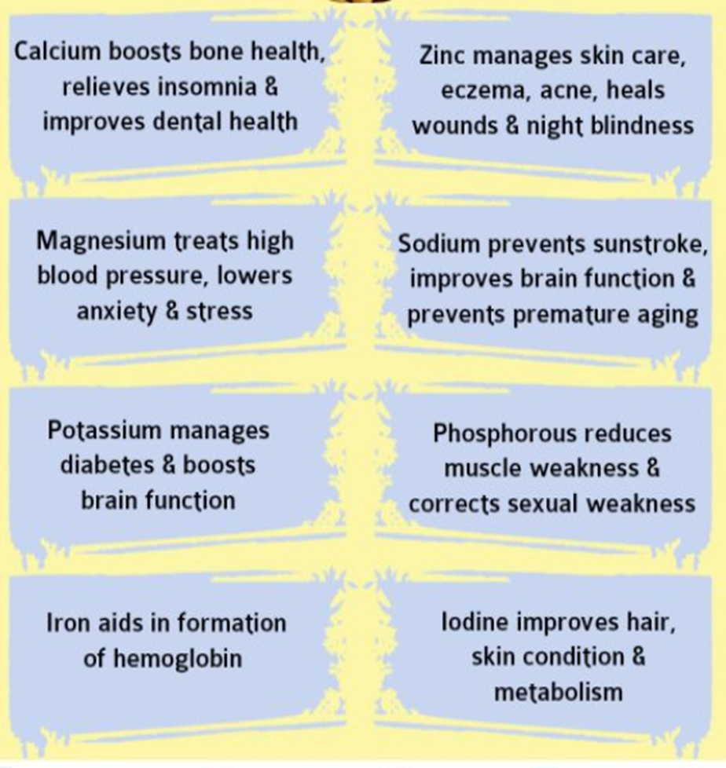
Minerals
Why are minerals important?
Builds strong bones and teeth
Blood
Skin
Hair
Nerve function
Muscle
Metabolic processes such as those that turn the food we eat into energy

Slide 9
Fiber
Type of carbohydrate that the body can’t digest. Though most carbohydrates are broken down into sugar molecules, fiber cannot be broken down into sugar molecules, and instead it passes through the body undigested.
Fiber helps regulate the body’s use of sugars, helping to keep hunger and blood sugar in check.
There are two types of fiber (both are important for health, digestion, and preventing diseases
SOLUBLE FIBER- attracts water and turn to gel during digestion. This slows the digestion down. It is found in oat bran, barley, nuts, seeds, beans, lentils, peas and some fruits and vegetables. Some types of soluble fiber may help lower the risk of heart disease.
INSOLUBLE FIBER- found in food such as wheat bran, vegetables, and whole grains. It will add bulk to the stool and it helps food pass more quickly through the stomach and intestines.

Slide 10
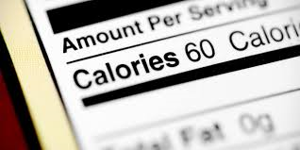
What is a calorie?
A heat unit referring to the energy available in food and the energy used by body activities.

Slide 11
How many calories are stored in 1 lb. of body fat?

Slide 12
Are all calories equal?
NO!!
All calories may have the same amount of energy (4184 joules)
Different foods go through different biochemical pathways, some of these and inefficient because the calorie ends up being lost as heat.
Different foods and macronutrients (a substance required in relatively large amounts by living organisms, in particular) have a major effect on the hormones and the brain and these control hunger and eating behavior.
The foods we eat can have a HUGE impact on the biological processes that govern when, what and how much we eat!
SO.. Not all calories are equal… think cotton candy vs. and apple…

Slide 13
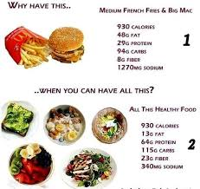

Slide 14
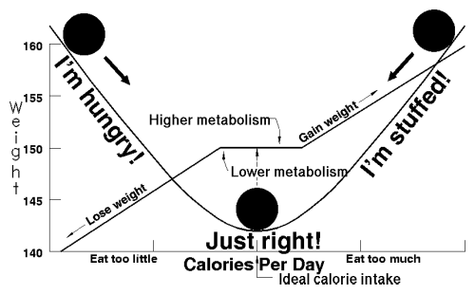
What is energy balance?
It is the relationship between “energy in” and “energy out”
ENERGY IN→ Food calories taken into the body through food and drink
ENERGY OUT→ calories being used in the body for our daily energy requirements (working out)

Slide 15
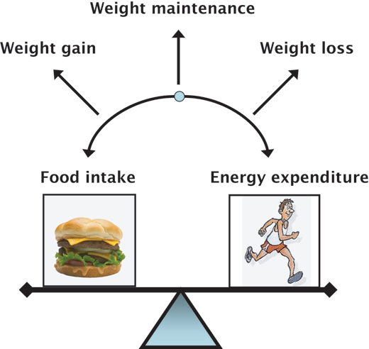
When your energy balance is equal
What does that mean??
The amount of calories you eat in a day equals the amount of calories you use (burn) in a day, resulting in a healthy metabolism and aiding in weight control.

Slide 16
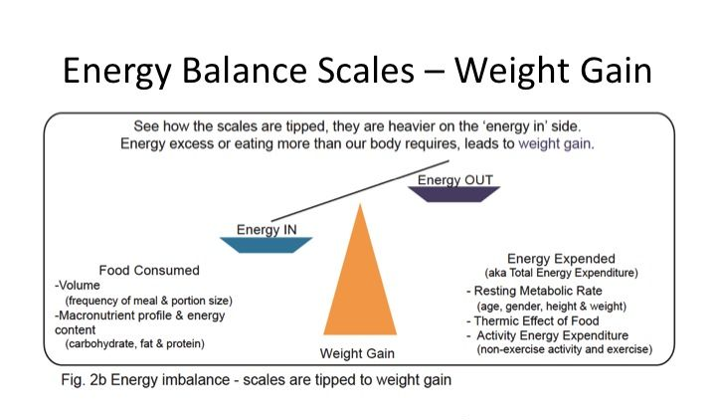
What does it mean when your energy balance in tipped?
Meaning that you are consuming more than you are using?
Leads to weight rain and increases the fat that is being stored

Slide 17
So do you have to have perfect balance all the time?
Your energy in and energy out doesn’t have to be perfectly balanced everyday. There will be days where it is balanced, or tipped in either directions.
It will then end up balancing overtime that will help you maintain your healthy weight.

Slide 18
Look at your sodium and sugars…
SODIUM→ It is an essential mineral for the human body
Most common form = table salt
Most of the salt that we get are in our processed foods; not what we add in our recipes
SUGAR→ simple, edible, crystalline, carbohydrate.
Main types =sucrose, lactose and fructose
Many foods are already processed with these sugars as well which is a concern

Slide 19
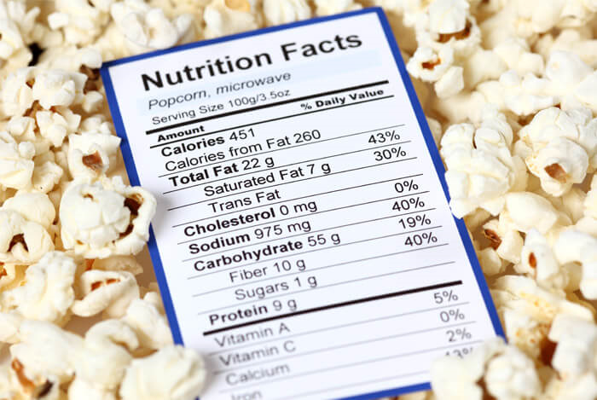
How do you know if there are more added sugars and sodium?
Read the nutrition label!!
Men shouldn’t exceed 37.5 grams of sugar
Women shouldn’t exceed 25 grams of sugar
Men and women shouldn’t exceed 1500 milligrams of sodium per day

Slide 20
CONCLUSION
What are some important items that you took away from todays lesson?

